Slide 1
Toughest Sports by Skill
By Kevin Angotti

Slide 2
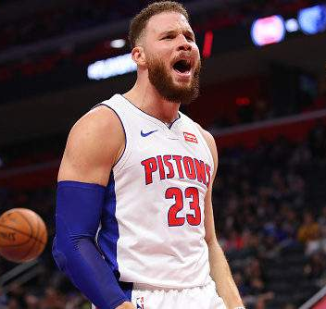
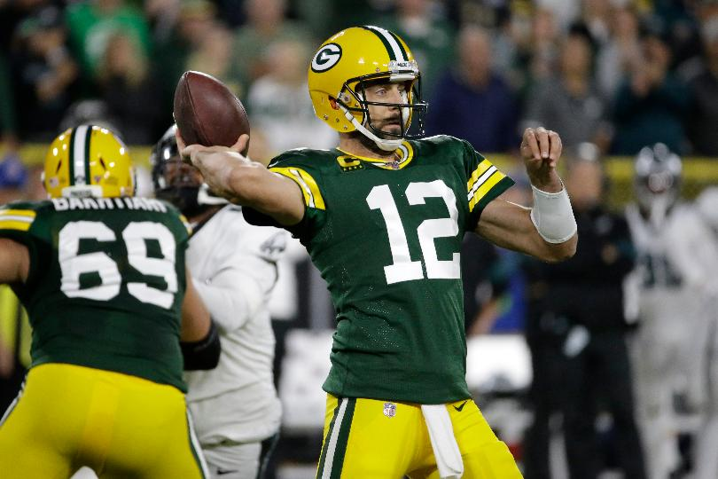
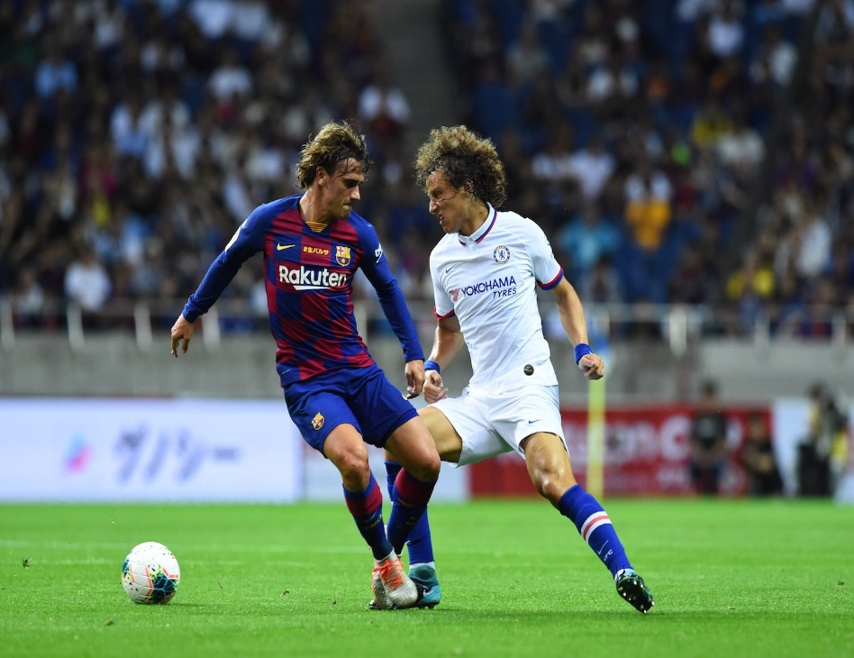
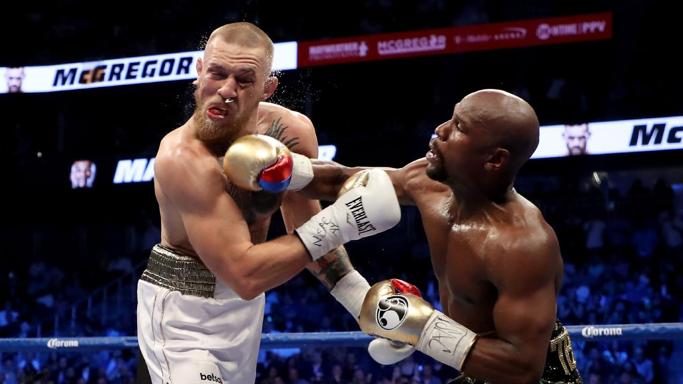
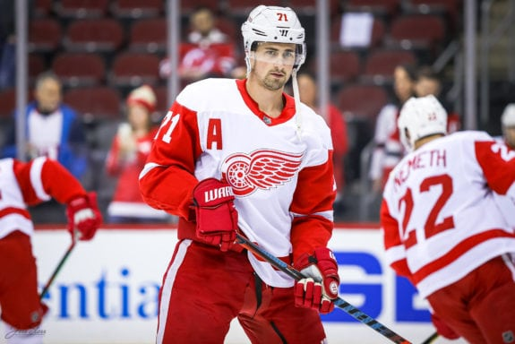
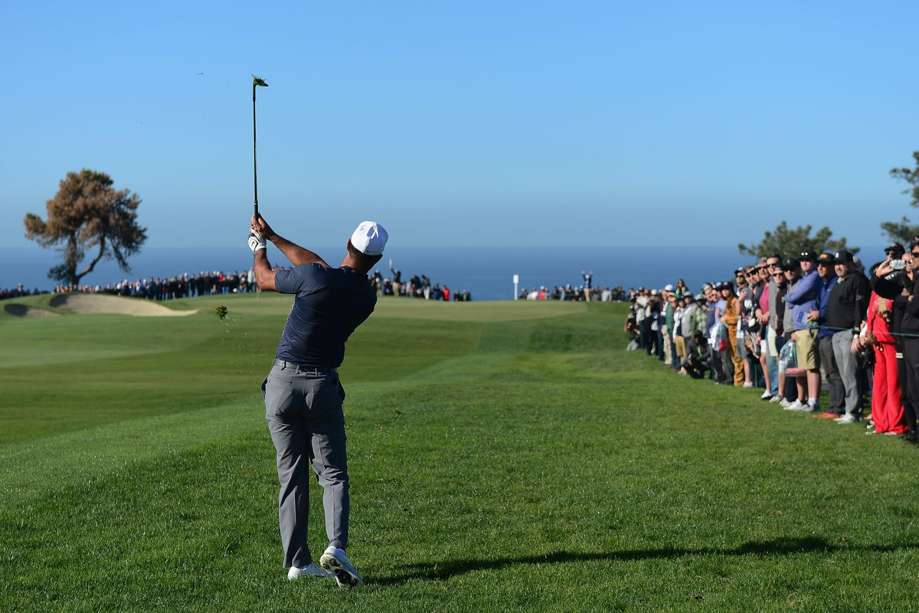
Which Sports are really tough to play?
NOTE:
To change images on this slide, select a picture and delete it. Then click the Insert Picture icon
in the placeholder to insert your own image.
For this semesters term project, I searched for data sets on data.gov and data.world, and after looking through many different data sets. I came across one that caught my attention. Since I am very much into sports, I narrowed my search toward that. From the data.world site, I thought about doing something on one of my three favorite sports (football, Hockey, Golf), but I happened to find a data set on Toughest Sports by Skill [1]. After looking through all of the data and looking at the potential variables I could use, I decided to run with it for this project. The dataset itself provides thirteen variables to measure across sixty different sports, all determined based on the various measurements ranks of the sixty sports were calculated by toughness. From the thirteen variables, I will focus on six with a possible seventh included.

Slide 3
Statistical question/hypothesis
Does the strength of an athlete contribute to a sports consideration of being toughest to play?
What attributes contributes the most to a sport being labeled as tough to play?
What attribute(s) cause the most harm, or are the least desirable to the overall score?
Can one attributes influence the overall ranking, or are multiple attributes required to make a sport the tough?
Are the toughest sports the most popular?
If there were financial data added in, i.e., have a variable, would the toughest sports by rank also be the most lucrative?
H0 – Popularity does not correlate with the toughness of a sport.
H1 – Popularity and sports toughness are correlated.

Slide 4
Variables this project focused on for analysis.
Strength
Endurance
Agility
Durability
Flexibility
Analytical Aptitude
Nerve (potential)

Slide 5
Variables continued. Meaning
Strength - The ability to produce force. Example: NFL linebackers.
Endurance - The ability to continue to perform a skill or action for long periods of time. Example: Lance Armstrong.
Agility - The ability to change direction quickly. Example: Derek Jeter, Mia Hamm.
Durability - The ability to withstand physical punishment over a long period of time. Example: NBA/NHL players.
Flexibility - The ability to stretch the joints across a large range of motion. Example: Gymnasts, divers.
Analytical Aptitude - The ability to evaluate and react appropriately to strategic situations. Example: Joe Montana reading a defense; basketball point guard on a fast break.
Nerve (potential) - The ability to overcome fear. Example: High-board divers, race-car drivers, ski jumpers.

Slide 6
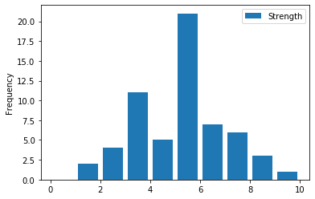
Strength
Variables continued.
Strength as seen here in the histogram follows close to the natural bell curve indicating a normal distribution for the variable in the overall ranking.

Slide 7
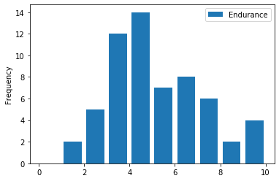
Endurance
Variables continued.
Endurance also follows close to a histograms natural bell curve indicating that there is significance for this variable in the overall ranking.

Slide 8
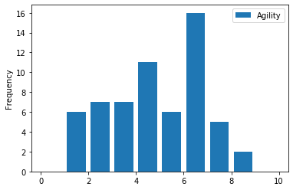
Agility
Variables continued.
Agility as seen here in the histogram is somewhat random as there is no real pattern to the its shape and the mode could be a contributing factor with its multiple peaks.

Slide 9
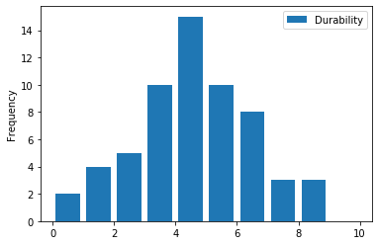
Durability
Variables continued.
Durability like Strength has a histogram shape that follows close to the natural bell curve indicating a normal distribution for the variable in the overall ranking.

Slide 10
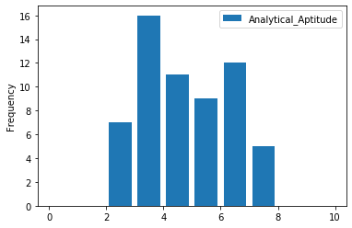
Analytical Aptitude
Variables continued.
Analytical Aptitude similar to Agility is somewhat random, there is no real pattern to the its shape and mode could be a contributing factor with its multiple peaks.

Slide 11
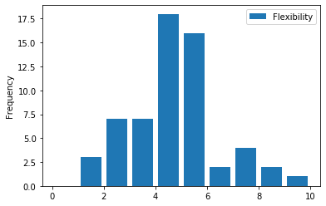
Flexibility
Variables continued.
Flexibility seen here has a distribution that seems to be in a sense skewed to the left and thought as negatively skewed. there are some outliers here. However, most of the data falls to the left side.

Slide 12
Summary Statistics for this project
Mean
Standard Deviation (Sd)
Variance (spread)
p-values by way of t-test of variables
Pearson’s correlation
Covariance

Slide 13
Summary Statistics for this project Cont.
Mean of each variable
Standard Deviation (Sd)
Computing p-value between two variables
Variance
Popularity | 215.5817
Endurance | 5.077667
Strength | 5.169
Power | 5.509167
Speed | 4.815
Agility | 4.765
Flexibility | 4.723167
Nerve | 4.614883
Durability | 4.612833
Hand-Eye Coordination | 4.954833
Analytical Aptitude | 4.767333
Total | 48.98333
Rank | 30.4
Popularity_Total | 3.593028
Popularity |  | 477.2986
Endurance |  | 2.094217
Strength |  | 1.715357
Power |  | 1.980397
Speed |  | 2.266403
Agility |  | 1.927273
Flexibility |  | 1.704369
Nerve |  | 2.442645
Durability |  | 1.882102
Hand-Eye Coordination |  | 1.966328
Analytical Aptitude |  | 1.57683
Total |  | 12.17052
Rank |  | 17.47366
Popularity_Total |  | 7.954977
Popularity | 224017.1
Endurance | 4.312648
Strength | 2.893409
Power | 3.856608
Speed | 5.050975
Agility | 3.652475
Flexibility | 2.856458
Nerve | 5.867075
Durability | 3.48327
Hand-Eye Coordination | 3.802005
Analytical Aptitude | 2.444953
Total | 145.6528
Rank | 300.24
Popularity_Total | 62.22696
p-values |  | Accept/Reject null
Strength to Popularity_Total | 0.13551926 | Accept
Agility to Popularity_Total | 0.222915355 | Accept
Endurance to Popularity_Total | 0.138803613 | Accept
Durability to Popularity_Total | 0.305673051 | Accept
Analytical Aptitude to Popularity_Total | 0.217236615 | Accept
Flexibility to Popularity_Total | 0.284613021 | Accept
Rank to Popularity_Total | 1.67E-13 | Reject

Slide 14
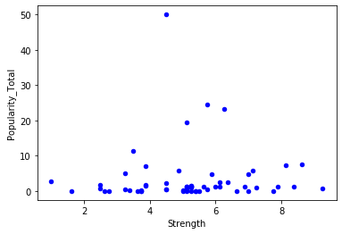
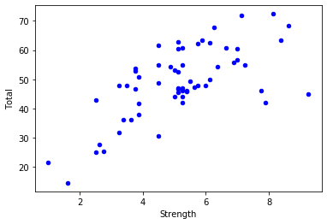
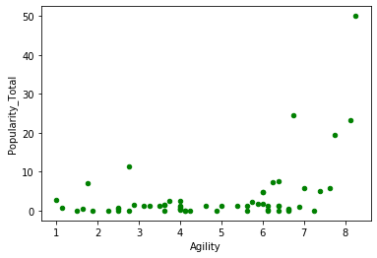
Summary Statistics for this project Cont.
Pearson's Correlation
Strength to Total | 0.6779275826
Strength to Popularity_Total | 0.042477757
Agility to Popularity_Total | 0.413586698
Endurance to Popularity_Total | 0.268119278
Durability to Popularity_Total | 0.279944714
Analytical Aptitude to Popularity_Total | 0.501463382
Flexibility to Popularity_Total | 0.017162246
Total to Popularity_Total | 0.367558603

Slide 15
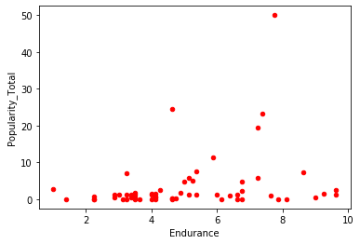
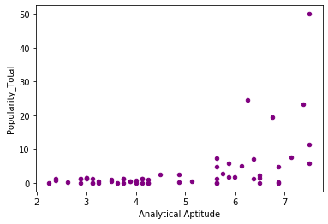
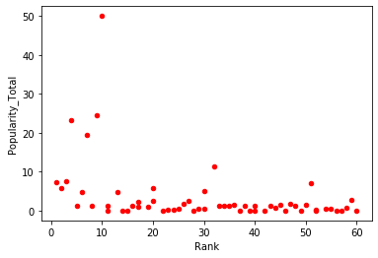
Summary Statistics for this project Cont.
Covariance
Strength to Total | 14.15294915
Strength to Popularity_Total | 0.579635565
Agility to Popularity_Total | 6.34086822
Endurance to Popularity_Total | 4.466718484
Durability to Popularity_Total | 4.191354553
Analytical Aptitude to Popularity_Total | 6.290179115
Flexibility to Popularity_Total | 0.232689402
Total to Popularity_Total | 35.58562688

Slide 16
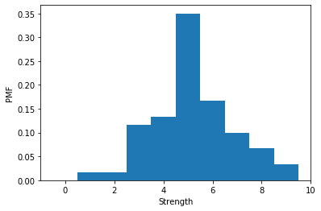
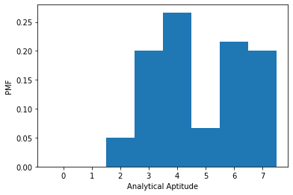
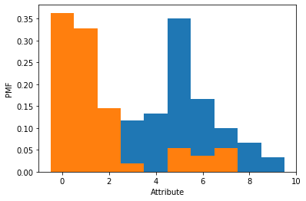
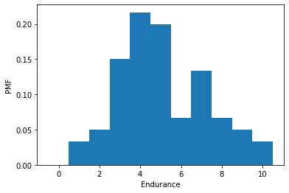
Probability Mass Functions (PMF)

Slide 17
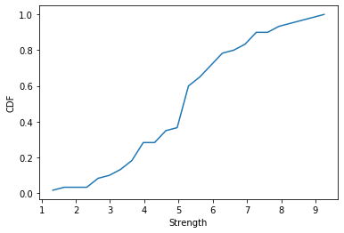
Cumulative Distribution Function (CDF)
50% percentile: | 5.190
90% percentile: | 7.300
95% percentile: | 8.143
100% percentile: | 9.250

Slide 18
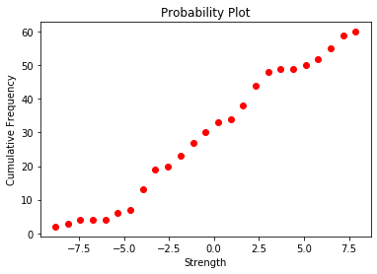
Analytical Distribution

